Slide 1
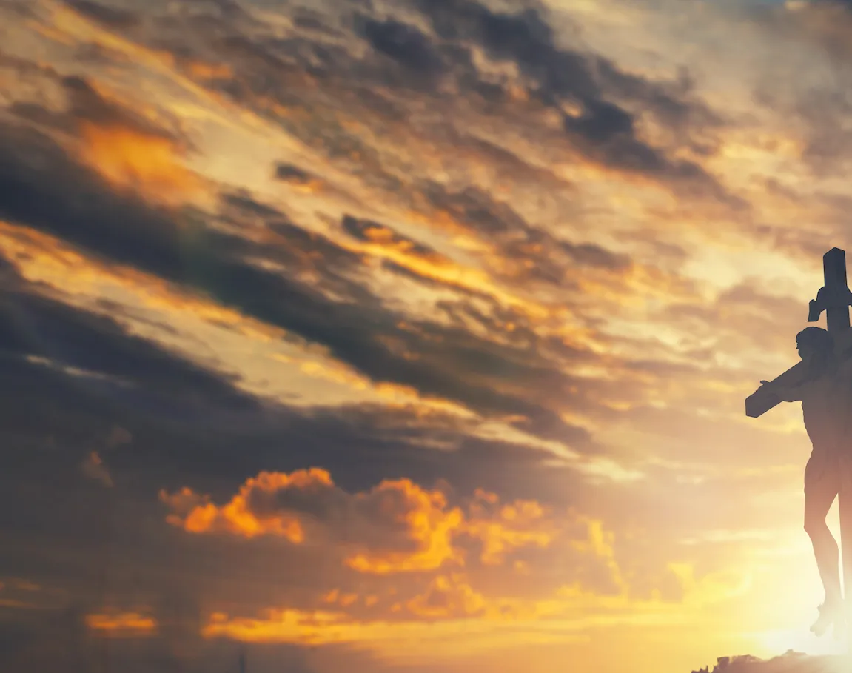
Only A Holy God

Slide 2
Am / C / F / C CAPO 2nd for Marina, Skyler
Am C F C
Who else commands all the hosts of heaven
Am C F C
Who else could make every king bow down
Am C F C
Who else can whisper and darkness trembles
F G C
Only a Holy God

Slide 3
Am C F C
What other beauty demands such praises
Am C F C
What other splendour outshines the sun
Am C F C
What other majesty rules with justice
F G C
Only a Holy God

Slide 4
Am F
Come and behold Him
C G
The One and the Only
Am F
Cry out, sing holy
C G Am
Forever a Holy God
F G
Come and worship the Holy God

Slide 5
Am C F C
What other glory consumes like fire
Am C F C
What other power can raise the dead
Am C F C
What other name remains undefeated
F G C
Only a Holy God

Slide 6
Am F
Come and behold Him
C G
The One and the Only
Am F
Cry out, sing holy
C G Am
Forever a Holy God
F G
Come and worship the Holy God
x2

Slide 7
Am C F C
Who else could rescue me from my failing
Am C F C
Who else would offer His only Son
Am C F C
Who else invites me to call Him Father
F G C
Only a Holy God

Slide 8
Am F
Come and behold Him
C G
The One and the Only
Am F
Cry out, sing holy
C G Am
Forever a Holy God
F G
Come and worship the Holy God
END

Slide 9
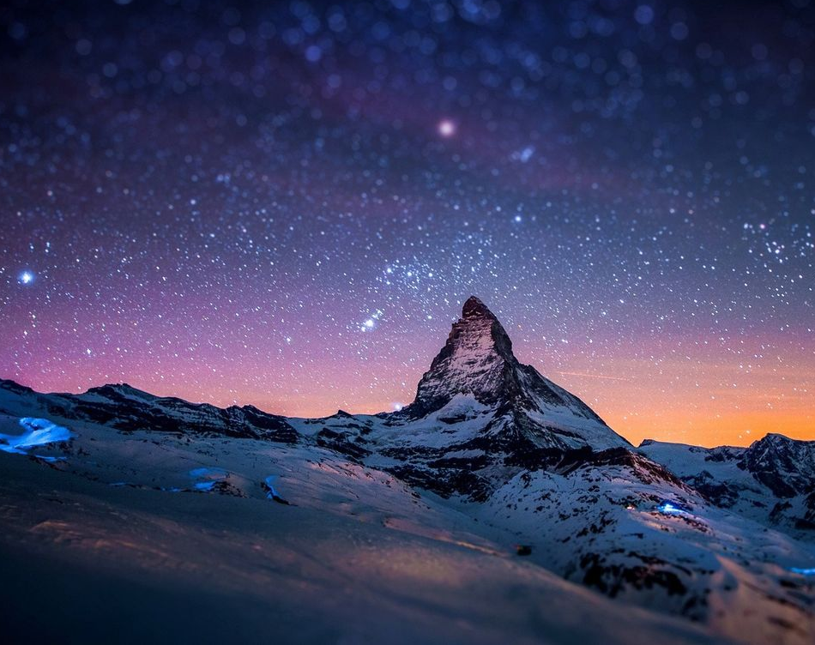
All sufficient merit

Slide 10
CAPO @ 4th
Am G F C F G
All sufficient merit Shining like the sun
Am G F C F G F C
A fortune I inherit By no work I have done
G Am F C
My righteousness I forfeit At my saviors cross
G Am F G C F
Where all sufficient merit Did what I could not

Slide 11
Am G F C F G
In love he condescended Eternal now in time
Am G F C F G C
A life without a blemish The maker made to die
G Am F C
The Law could never save us Our lawlessness had won
G Am F G C
Until the pure and spotless Lamb had finally come

Slide 12
G Am Em
It is done It is finished
F C
No more debt I owe
G
Paid in full
Am Em F G
All sufficient merit now my own

Slide 13
Am G F C F G
I lay down my garments Any empty boast
Am G F C F G C
Good works now all corrupted By the sinful host
G Am
Dressed in my LORD Jesus
F C
A crimson robe made white
G Am F G C
No more fear of judgement His righteousness is mine

Slide 14
G Am Em
It is done It is finished
F C
No more debt I owe
G
Paid in full
Am Em F G
All sufficient merit now my own

Slide 15
Am G F C F G
All sufficient merit Firm in life and death
Am G F C F G C
The joy of my salvation Shall be my final breath
G Am F C
When I stand accepted Before the throne of God
G Am F G C
I’ll gaze upon my Jesus And thank Him for the cross
F G C
Yes I’ll thank Him for the cross

Slide 16
G Am Em
It is done It is finished
F C
No more debt I owe
G
Paid in full
Am Em F G
All sufficient merit now my own
X2 andEND

Slide 17
Build My Life

Slide 18
G C / G C
G C
Worthy of every song we could ever sing
G C
Worthy of all the praise we could ever bring
G C
Worthy of every breath we could ever breathe
G
We live for You
C
We live for You

Slide 19
G C
Jesus the name above every other name
G C
Jesus the only one that could ever save
G C
Worthy of every breath we could ever breathe
G
We live for You
C
We live for You

Slide 20
C Am G
Holy there is no one like You There is none beside You
Em C
Open up my eyes in wonder and Show me who You are
Am
And fill me with Your heart
G
And lead me in Your love
Em C
to those around me

Slide 21
G C
Jesus the name above every other name
G C
Jesus the only one that could ever save
G C
Worthy of every breath we could ever breathe
G
We live for You
C
Oh We live for You

Slide 22
C Am G
Holy there is no one like You There is none beside You
Em C
Open up my eyes in wonder and Show me who You are
Am
And fill me with Your heart
G
And lead me in Your love
Em C
to those around me

Slide 23
C D Em
I will build my life, upon Your love
G
It is a firm foundation
C D Em
I will put my trust, in You alone
G
And I will not be shaken
play twice & to chorus

Slide 24
C Am G
Holy there is no one like You There is none beside You
Em C
Open up my eyes in wonder and Show me who You are
Am
And fill me with Your heart
G
And lead me in Your love
Em C
to those around me
END

Slide 25
I Stand Amazed in the Presence

Slide 26
G
I stand amazed in the presence
D G
Of Jesus the Nazarene
C G
And wonder how He could love me,
G D G
A sinner, condemned, unclean.

Slide 27
G
How marvelous, How wonderful
D
And my song shall ever be:
G Em
How marvelous, How wonderful
Am G D G
Is my Savior's love for me

Slide 28
G
He took my sins and my sorrows;
D G
He made them His very own
C G
He bore the burden to Calvary,
G D G
And suffered and died alone

Slide 29
G
How marvelous, How wonderful
D
And my song shall ever be:
G Em
How marvelous, How wonderful
Am G D G
Is my Savior's love for me

Slide 30
G
When with the ransomed in glory,
D G
His face I at last shall see
C G
’Twill be my joy through the ages
G D G
To sing of His love for me

Slide 31
G
How marvelous, How wonderful
D
And my song shall ever be:
G Em
How marvelous, How wonderful
Am G D G
Is my Savior's love for me
END

Slide 32
Amazing Grace

Slide 33
G C G
Amazing Grace how sweet the sound
G D
That saved a wretch like me
G C G
I once was lost but now am found
G D G
Was blind but now I see

Slide 34
G C G
T'was Grace that taught My heart to fear
G D
And Grace, my fears relieved
G C G
How precious did that Grace appear
G D G
The hour I first believed

Slide 35
G C G
Through many dangers Toils and snares
G D
I have already come
G C G
’Tis grace hath brought me safe thus far
G D G
And grace will lead me home

Slide 36
G C G
The Lord has promised good to me
G D
His Word my hope secures
G C G
He will my Shield and Portion be
G D G
As long as life endures
END

